Slide 1

#XamExpertDay

Slide 2
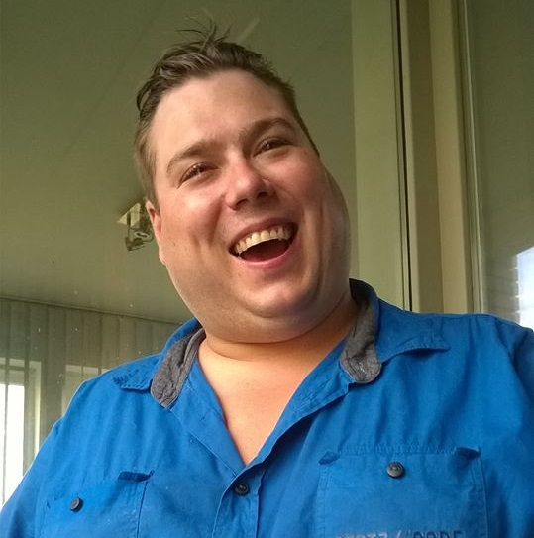

Improving people with disabilities’ life With Xamarin.Essentials
Dennie Declercq
@DennieDeclercq

Slide 3


Slide 4
Intro

Slide 5

Agenda
Who am I?
People with disabilities
Accessible Design Basics
Our demo project
Xamarin.Essentials
Xamarin.Essentials for Accessibility
Xamarin.Essentials beyond accessibility
Q&A

Slide 6
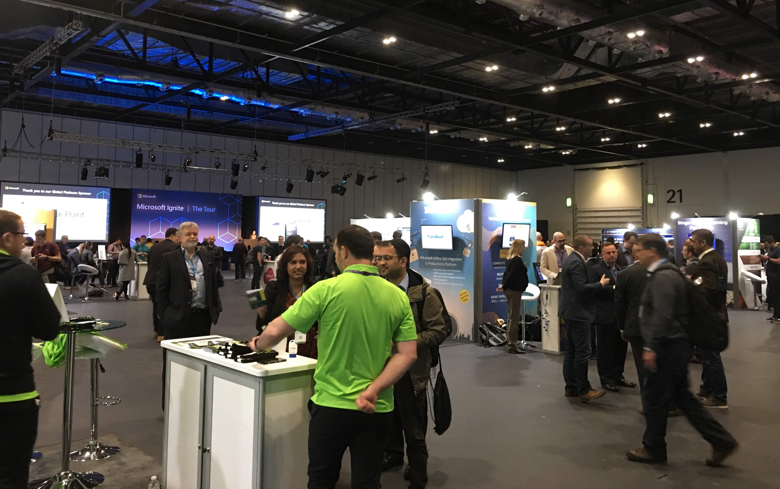
About me
Dennie Declercq
Microsoft MVP
DDSoft nonprofit (Belgium)
Autism
@DennieDeclercq
#DreamingIsBelieving
Notes:
Who I am? I am Dennie Declercq, I am a volunteer developer. I make software for people with disabilities in Flanders. I have my own disability autism. You can follow me on twitter @Dennie Declercq and I am the inventor of the hashtag #DreamingIsBelieving a hashtag for all my speaker career dreams.

Slide 7

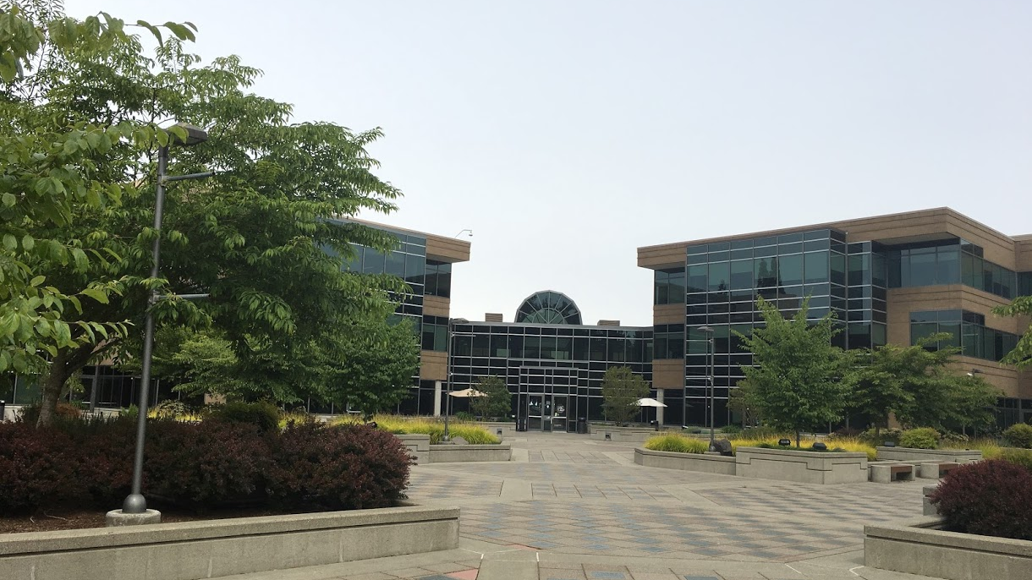
❤#7ThYearMagic 🦋
Notes:
I have some more: This year is #7ThYearMagic! What is #7ThYearMagic? #7ThYearMagic started by the end of 2018 when I realised myself that in 2019 it’s 7 years that I am volunteering. 7 is a magic number and in 2019 my live dream will com thru! And this is goig to the United States as as speaker … .. .. ….

Slide 8
People With Disabilities

Slide 9

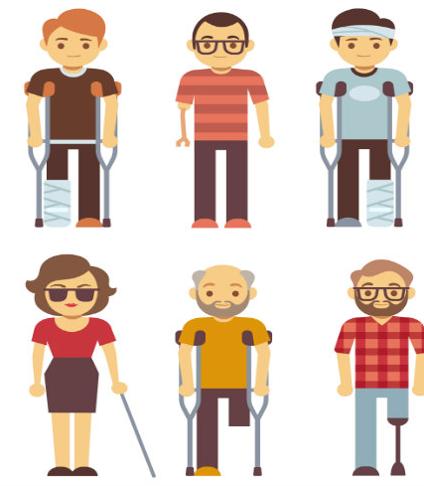
People!
PWD are People
People
Thread human
Help Human

Slide 10
Kind of disabilities
Intellectual / Cognitive
Autism
Visual
Auditory
Motoric
Much more…

Slide 11
Cognitive / Intellectual Disability?
Significant limitations in both:
Intellectual functioning
Adaptive behavior

Slide 12

Cognitive / Intellectual Disability?
Intellectual Functioning
Adaptive Behavior
Also called intelligence
Mental capacity
IQ score between 70-75
Conceptual Skills
Language/literacy
Money
Time/numbers
Social Skills
Social responsibility
Self-esteem
Practical skills
Activities daily living
Personal care / healthcare
Notes:
Conceptual Skills – Language and literacy: money, time, and number concepts, and self-direction
Social Skills – interpersonal skills, social responsibility, self-esteem, wariness,, …
Practical skills – activities of daily living (personal care), healthcare, travel/transportation

Slide 13
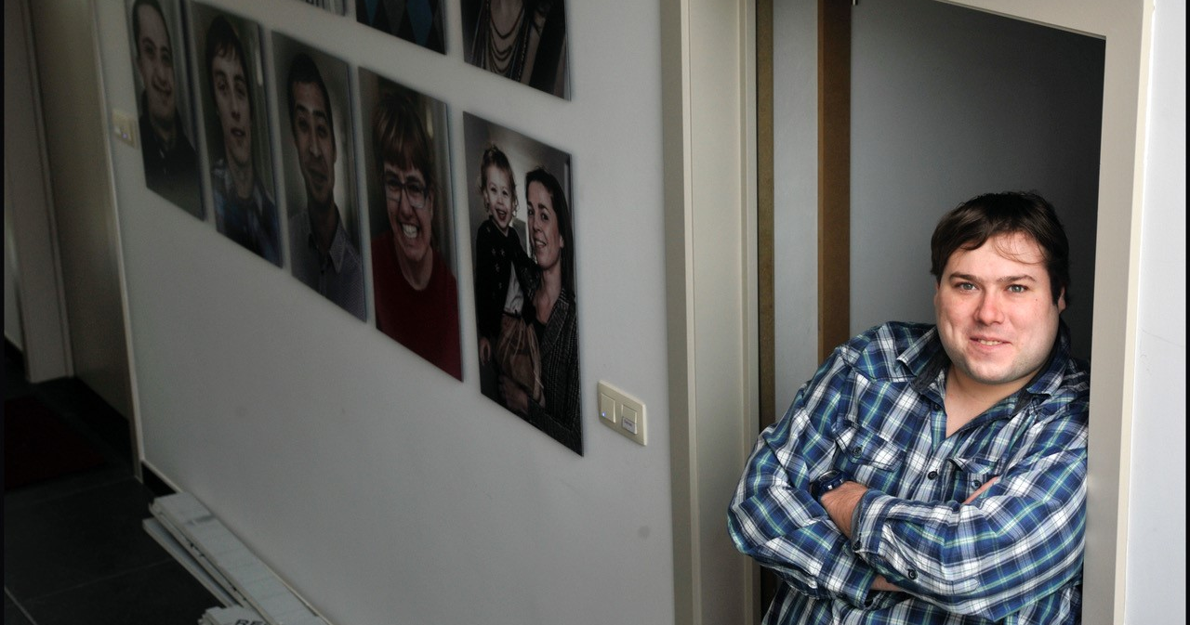
Principles of Inclusion
Same activities
Same district
Work Together
Adjustments par person
Notes:
People with disability doing the same activities as people without disability.
People with and without disability are living in the same district.
People with and without disability work together.
The needed adjustments are made par person.
why Do I put myself into this picture? Because I even have my own disability, I have autism and live in a inclusive living project togheter with people with intellectual disabilities and people without disabilities.

Slide 14

Digital Difficulties for p.w.d.
Cognitive / Intellectual Disability
Read
Understand
Autism
Understand
See structure
Blindness or vision loss
Decreased ability to read
Decreased ability to navigate
Auditory disabilities
Hearing notifications
Following movies without audio description.
Motoric disabilities
Controlling smartphone or pc.
Notes:
Difficulties are different par disability
Most helping apps are made par disability

Slide 15
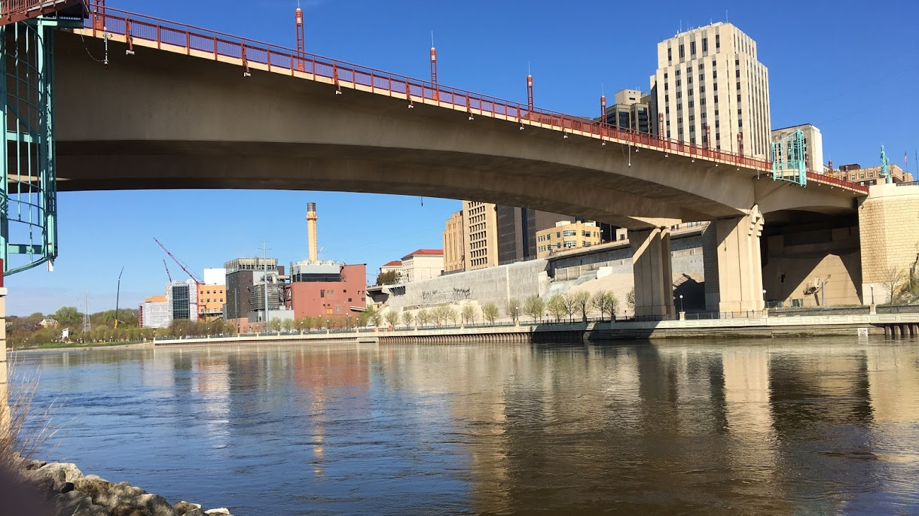
Our Focus
People with cognitive / intellectual disabilities
Autism
People with mental health issues

Slide 16
Accessible Design Basics

Slide 17

Simplify the layout
Simplify the layout
Less content par screen
Logical content par screen
Light or white background
A few accent colors
Notes:
Maybe this slide is boring for you, maybe it’s not the most beautifull slide of this slidedeck. But for people with disabilities it’s easy to read. It’s simple. There’s no concentration needed to follow to understand the layout, and there’s no knowledge needed and no distraction. (+scherm)

Slide 18
Dark color theme
Effective: People with Autism

Slide 19
Color Contrast
Make enough contrast!
Needed for a lot of people!

Slide 20

Color By Function
I can speak
I open another page
I can navigate
Notes:
Here I created three button styles: the yellow button can speak, the gray button navigates in a dataset and the blue button navigates to another screen. If you have more

Slide 21

Pictures and Pictograms
What means the following?
酢飯
The answer is:
Notes:
What means the following?
Anyone knows?
The answer is
RICE
For some people with a disability, who cannot read,
Letters and words means nothing.
Just like chinese tokens for us.
Everybody (except people with visual impairments) can see a picture.

Slide 22
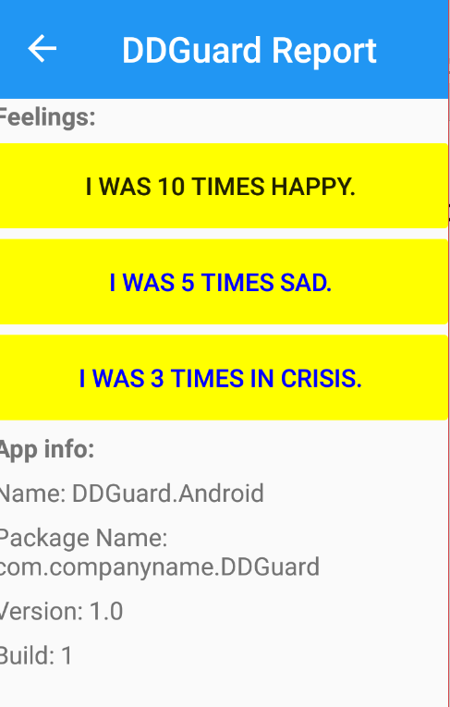
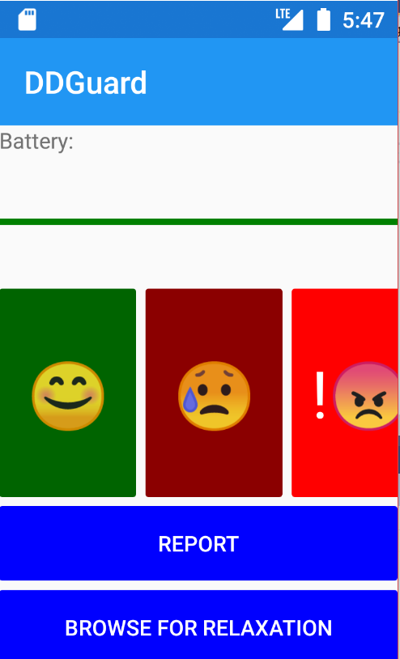
Our demo app: ‘DDGuard’
Disability + Metal Health
Emotion tracker
Calming down
GitHub
(Feel free to contribute)
https://github.com/DDSoftDennie/DDGuard

Slide 23
Xamarin.Essentials

Slide 24



Xamarin.Essentials
Shared UI Code
Shared Platform Extensions (Xamarin.Essentials)
Shared C# Backend

Slide 25
Xamarin.Essentials API’s
Accelerometer App Information Barometer Battery Clipboard Color Converters Compass Connectivity Detect Shake Device Display Information Device Information Email File System Helpers Flashlight | Geocoding Gyroscope Launcher Magnetometer Main Thread Maps Open Browser Orientation Sensor Phone Dialer Platform Extensions Preferences Secure Storage | Share SMS Text-To-Speech Unit Converters Version Tracking Vibrate

Slide 26
Getting Started with Xamarin.Essentials
Installing NuGet Package
Using Statement
Most of the time a single line of code
using Xamarin.Essentials;

Slide 27
Xamarin.Essentials For Accessibility

Slide 28
Text-To-Speech – Use Case
Reading Difficulties
Complete word-blind
Confirmation
Dyslexia

Slide 29
Text-To-Speech - Code
private async void HappyButton_Clicked(object sender, EventArgs e)
{
//Xamarin.Essentials: Text To Speech
await TextToSpeech.SpeakAsync(HappyButton.Text);
}

Slide 30
Xamarin.Essentials Beyond Accessibility

Slide 31
Preferences: Use Case
Saving Information
Limit Data Usage

Slide 32
Preferences: Code
//Xamarin.Essentials: Preferences
Preferences.Set("Happy", Statics.Happy);
//Xamarin.Essentials: Preferences
Statics.Happy = Preferences.Get("Happy", 0);

Slide 33
Battery: use Case
People forgot loading device
Problems with prediction battery state
Device Out of functioning in critic situation

Slide 34
Battery: How to handle?
Visual
With colors
With auditory warning

Slide 35
Battery: Code
//Xamarin.Essentials: Battery
//PERMISSIONS: BATTERY_STATS
double dBattery = Battery.ChargeLevel;
BatteryProgressBar.Progress = dBattery;
if(dBattery <= 0.20)
{
BatteryProgressBar.ProgressColor = Color.Red;
SpeakBattery();
} else if(dBattery <=0.35)
{
BatteryProgressBar.ProgressColor = Color.Orange;
} else {
BatteryProgressBar.ProgressColor = Color.Green;
}

Slide 36
Connectivity: Use Case
No Data available
People don’t know there’s no data connection
App crashes without data
People are confused

Slide 37
Connectivity: Code
//Xamarin.Essentials: Connectivity
var connection = Connectivity.NetworkAccess;
if(connection == NetworkAccess.Internet)
{
NoConnectionButton.IsVisible = false;
return true;
}
else
{
NoConnectionButton.IsVisible = true;
return false;
}

Slide 38
Launcher: Use Case
Show your privacy statements
Open online media
Show movies (YouTube)

Slide 39
Launcher: Code
if(CheckInternetConnection() == true)
{
//Xamarin.Essentials: Launcher
await Launcher.OpenAsync("https://www.youtube.com/watch?v=nPbWxaF0D-U");
}

Slide 40
AppInfo: Use Case
Parents / Caregiver don’t know current app info
Lack of knowledge system settings

Slide 41
AppInfo: Code
//Xamarin.Essentials: AppInfo
AppNameLabel.Text += " " + AppInfo.Name;
AppPackageLabel.Text += " " + AppInfo.PackageName;
AppVersionLabel.Text += " " + AppInfo.VersionString;
AppBuildLabel.Text += " " + AppInfo.BuildString;

Slide 42
DeviceInfo: Use Case
Same as AppInfo:
Lack of knowledge parent / caregiver

Slide 43
DeviceInfo: Code
//Xamarin.Essentials: DeviceInfo
DeviceModelLabel.Text += " " + DeviceInfo.Model;
DeviceManufacturerLabel.Text += " " + DeviceInfo.Manufacturer;
DevicePlatformLabel.Text += " " + DeviceInfo.Platform;
DeviceOSLabel.Text += " " + DeviceInfo.VersionString;

Slide 44
Watching our demo again (full attention)

Slide 45


Thanks
Dennie Declercq
DDSoft nonprofit (Belgium)
@DennieDeclercq
#DreamingIsBelieving
Notes:
Who I am? I am Dennie Declercq, I am a volunteer developer. I make software for people with disabilities in Flanders. I have my own disability autism. You can follow me on twitter @Dennie Declercq and I am the inventor of the hashtag #DreamingIsBelieving a hashtag for all my speaker career dreams.

Slide 46
Q & A

Slide 47
Thank You!

